Slide 1


Vinicius Castillo de Lima
19/05/2022

Slide 2

Outline
Executive Summary
Introduction
Methodology
Results
Conclusion

Slide 3
Executive Summary
Introduction – slide 3
Methodology – slide 5
Summary – slide 6
Data collection – slide 7
Data Wrangling – slide 10
EDA – slide 11
Folium map – slide 13
Dashboard – slide 14
Predictive Analysis – slide 15
Results – slide 16
Insights drawn from EDA – slide 17
Launches sites proximities analysis – slide 34
Build a dashboard with plotly dash – slide 38
Predictive Analysis – slide 42
Conclusions – slide 45

Slide 4
Introduction
In this project I will take the disponible data of Space X to analysis what make the launches have a success landing
I will make some analysis to understand better the data set, like some charts, statistics and a folium map
Some charts I will try to create on a dashboard to anyone could make their analysis
And I will try to find the best model to predict the landing success

Slide 5

Section 1

Slide 6
Methodology
Executive Summary
Data collection methodology:
Use Space X API and web scrapping
Perform data wrangling
Create a Class label to identify the booster successfully landed or not.
Perform exploratory data analysis (EDA) using visualization and SQL
Perform interactive visual analytics using Folium and Plotly Dash
Perform predictive analysis using classification models
Try 4 models and find the best parameters of each one with Grid Search CV.
Choose the better model using accuracy and confusion matrix

Slide 7
Data Collection
Collect data from SpaceX API link: https://api.spacexdata.com/v4/launches/past (a static response could be access here)
Use requests python library to capture the data from the API and make some treatments to make the dataset.
More details on the next slide
Other font of data is Wikipedia List of Falcon 9 and Falcon Heavy launches
Use requests and beautifulsoup4 python library to capture the data from the Wikipedia and make some treatments to make the dataset.
More details ahead on the Data Collection – Scraping slide

Slide 8
Data Collection – SpaceX API
Get Data from the API
Select the features
Remove rows with multiple cores
Convert format of date feature to date
Select date <= 2020/11/13
Treat the features selected to find the features that will be used
Link GitHub: Data_Science_IBM_Certificate_Capstone_Project/Data Collection API.ipynb

Slide 9
Data Collection – Scraping
Get HTML Data
Select the third table in html data
Take the columns names
Take each element of the columns
Create a data frame with the data taken
Link GitHub: Data_Science_IBM_Certificate_Capstone_Project/Data Collection with Web Scraping.ipynb

Slide 10
Data Wrangling
Become to explorer the data to understood some features and find the better way do create a Training Labels
Create a Training Labels with 1 means the booster successfully landed 0 means it was unsuccessful
Link GitHub: Data_Science_IBM_Certificate_Capstone_Project/Data wrangling.ipynb

Slide 11
EDA with Data Visualization
Scatterplots to see some correlations:
Flight Number vs. Payload Mass colored by success or not
Flight Number vs. Launch Site colored by success or not
Payload mass vs. Launch Site colored by success or not
Flight Number vs. Orbit colored by success or not
Payload mass vs. Orbit colored by success or not
Bar chart to see the success rate of each orbit type
Line plot to observe the annual evolution of the average success rate
Link GitHub: Data_Science_IBM_Certificate_Capstone_Project/EDA with Visualization.ipynb

Slide 12
EDA with SQL
View the launch site options
Total payload mass carried by boosters launched by NASA (CRS)
Average payload mass carried by booster version F9 v1.1
First successful landing outcome in ground pad
List of the boosters which have success in drone ship
Total number of successful and failure mission outcomes
List of the booster which have carried the maximum payload mass
Booster versions and launch site that failed outcome in drone ship in year 2015
Count of landing outcomes between the date 2010-06-04 and 2017-03-20
Link GitHub: Data_Science_IBM_Certificate_Capstone_Project/EDA with SQL.ipynb

Slide 13
Build an Interactive Map with Folium
Create a folium map with circles and marks on the launch sites
Create green marks for launch was successful on landing and red marks for launch was failed
Create line and marks to show the distance between the launch site of Florida to:
Closest coastline
Closest railway
Closest highway
Closest cities
Link GitHub: Data_Science_IBM_Certificate_Capstone_Project/Interactive Visual Analytics with Folium.ipynb

Slide 14
Build a Dashboard with Plotly Dash
Created a dashboard with a pie chart with the success launches for each launch site
Included a scatter chart with the correlation between the payload mass vs. success or fail on landing and colored by the booster version
Included a possible to select the Launch Site to filter both plots
Included a possible to choose the payload mass range to filter the scatter plot
Link GitHub: Data_Science_IBM_Certificate_Capstone_Project/Dashboard with Plotly Dash.py

Slide 15
Predictive Analysis (Classification)
We take the data with the categorical features transformed by one hot encoding, this transformation was made on the EDA with Data Visualization
Separate the features data (X) and the target (Y)
Apply standard scaler on the features
Separate the data between train and test sets
Find the best parameters of each model (logistic regression, support vector machine, decision tree and k nearest neighbors) with Grid Search CV
Use accuracy and confusion matrix to find the best model
Link GitHub: Data_Science_IBM_Certificate_Capstone_Project/Machine Learning Prediction.ipynb

Slide 16
Results
Exploratory data analysis results (section 2 and 3)
Interactive analytics demo in screenshots (section 4)
Predictive analysis results (section 5)

Slide 17

Section 2

Slide 18
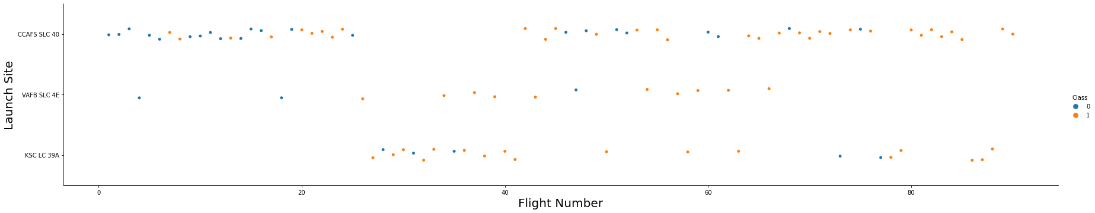
Flight Number vs. Launch Site
This chart show us that CCAFS LC-40 success ratio is lower than the others

Slide 19
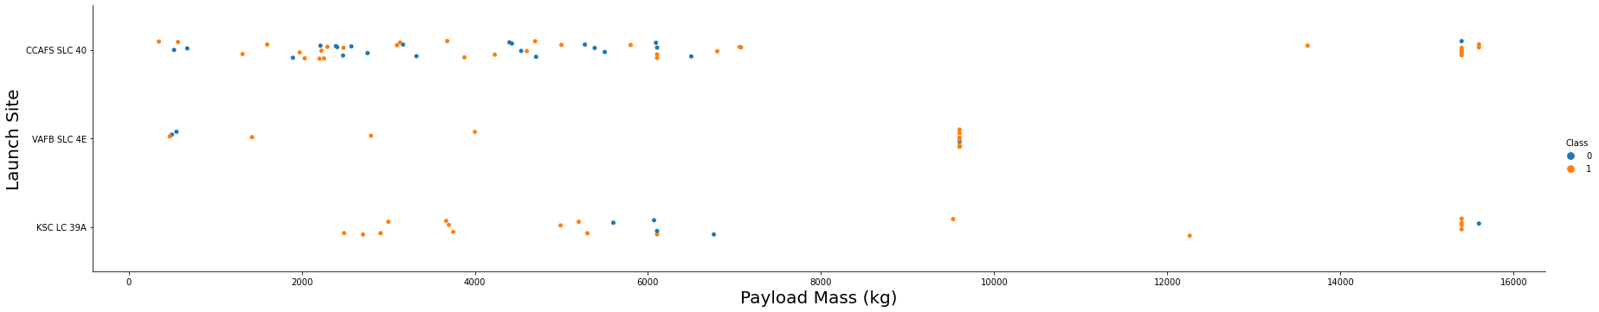
Payload vs. Launch Site
Here we can see the reduction of the success when the payload is great than 6000 kg
Another observation is the max payload mass launch from VAFB-SLC site is lower than 10.000 kg

Slide 20
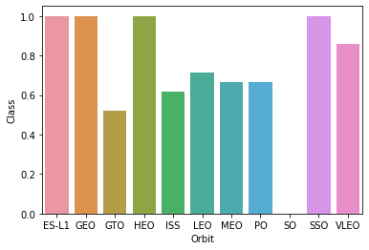
Success Rate vs. Orbit Type
Here we can see the orbits ES-L1, GEO, HEO and SSO had 100% of success ratio while the orbit SO had 100% of failure

Slide 21
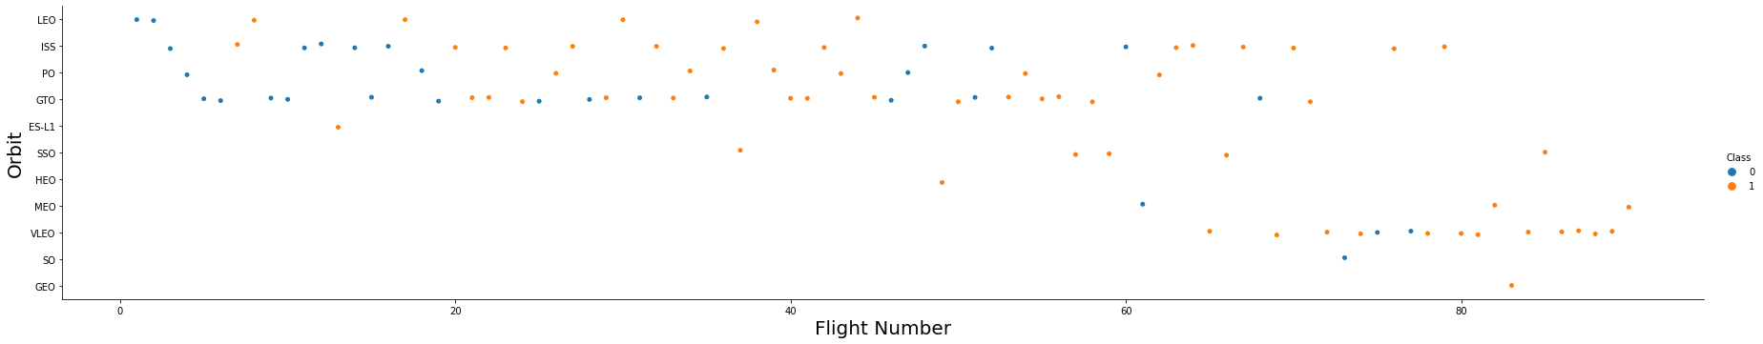
Flight Number vs. Orbit Type
We could see that in the LEO orbit the Success appears related to the number of flights
Others such as GTO don’t appears have any correlation

Slide 22
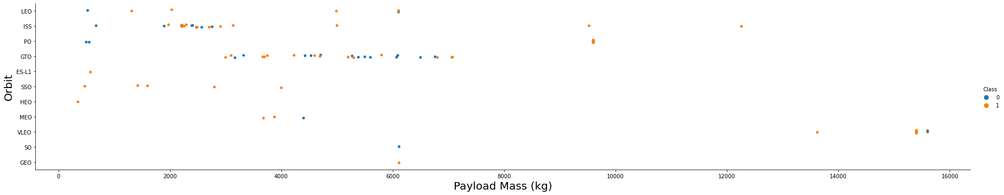
Payload vs. Orbit Type
Like on the chart before, the correlation is easily observed on orbit LEO and is difficult to see on the GTO.

Slide 23
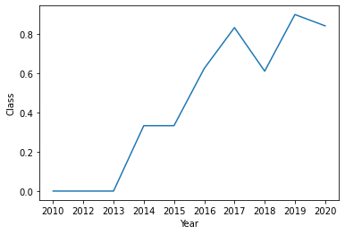
Launch Success Yearly Trend
We can see the success rate increases with the years

Slide 24
All Launch Site Names
We discovered that have only four launch sites, and they are:
CCAFS LC-40
CCAFS SLC-40
KSC LC-39A
VAFB SLC-4E

Slide 25
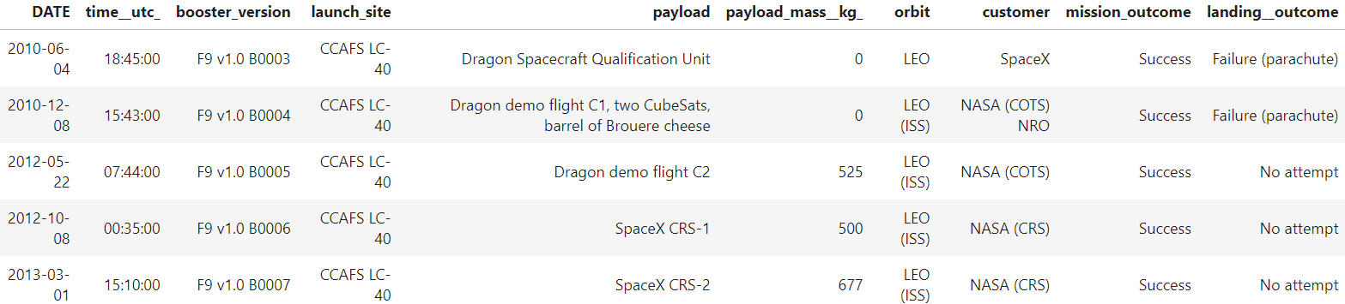
Launch Site Names Begin with 'CCA'
When we look to the five first records where launch sites begin with `CCA`, no one had success on landing, but the mission was successful
Present your query result with a short explanation here

Slide 26
Total Payload Mass
The total payload mass carried by boosters launched by NASA(CRS) was 45596 kg.

Slide 27
Average Payload Mass by F9 v1.1
The average payload mass carried by booster version F9 v1.1 was 2534 kg

Slide 28
First Successful Ground Landing Date
The first successful landing outcome in ground pad was achieved in 2015/12/22

Slide 29
Successful Drone Ship Landing with Payload between 4000 and 6000
The boosters which have successfully landed on drone ship and had payload mass greater than 4000 but less than 6000 was:
F9 FT B1022
F9 FT B1026
F9 FT B1021.2
F9 FT B1031.2

Slide 30
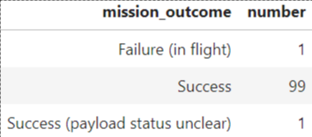
Total Number of Successful and Failure Mission Outcomes
When we see the number of successful and failure mission outcomes, we see only one failure on 101 launches.

Slide 31
Boosters Carried Maximum Payload
The booster which have carried the maximum payload mass was:
F9 B5 B1048.4
F9 B5 B1048.5
F9 B5 B1049.4
F9 B5 B1049.5
F9 B5 B1049.7
F9 B5 B1051.3
F9 B5 B1051.4
F9 B5 B1051.6
F9 B5 B1056.4
F9 B5 B1058.3
F9 B5 B1060.2
F9 B5 B1060.3

Slide 32
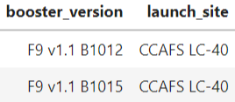
2015 Launch Records
The booster versions and launch site names of the failed landing outcomes in drone ship, for in year 2015 was:

Slide 33
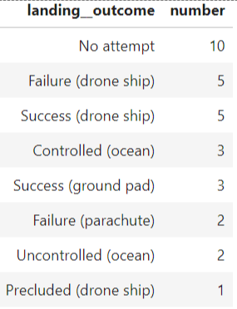
Rank Landing Outcomes Between 2010-06-04 and 2017-03-20
The count of landing outcomes (such as Failure (drone ship) or Success (ground pad)) between the date 2010-06-04 and 2017-03-20, in descending order was:

Slide 34

Section 3

Slide 35
Map of the launch sites
In this map appears all launch sites with the number o launches happened on them

Slide 36
Color mark for launches
Here are the marked red the launches was failure and green the launches was success

Slide 37
Distances from the launch site
This have lines and the distance from some points, like closest coastline and highway

Slide 38

Section 4

Slide 39
Launch sites success on dashboard
This first chart on the dashboard show the total success launches of each launch site
Is possible to see the KSC LC launch site have more launches with success than the others

Slide 40
The most success ratio
This is the chart of the launch site with the most success ratio
It is the same launch site that have the most success launches observed before

Slide 41
Payload and Booster Version vs. Success
View all sites information together is possible to see some concentration of colors in fail (class = 0) range
When is selected the booster versions v1.0 and v1.1 almost all points is in failure range
Other think is the range (2000 until 4000 kg) of the payload have the most success on landing

Slide 42

Section 5

Slide 43
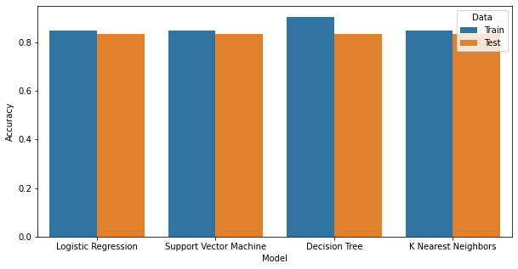
Classification Accuracy
All models had the same accuracy and confusion matrix with the test data
The best model is the Decision Tree, because in the train set had the best accuracy – 90% and, as said before, the same result of the others model on the test data

Slide 44
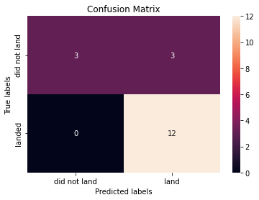
Confusion Matrix
The model could distinguish between the different class
The problem is the false positive

Slide 45
Conclusions
We find a good model with accuracy of 83,33%
We can observe some interesting correlations such as orbit, payload mass and the success
We could calculate the distance between the launch site and some important locals and see that have security distance to important sights like cities
We create a dashboard where anyone could take their analysis

Slide 46


